Slide 1
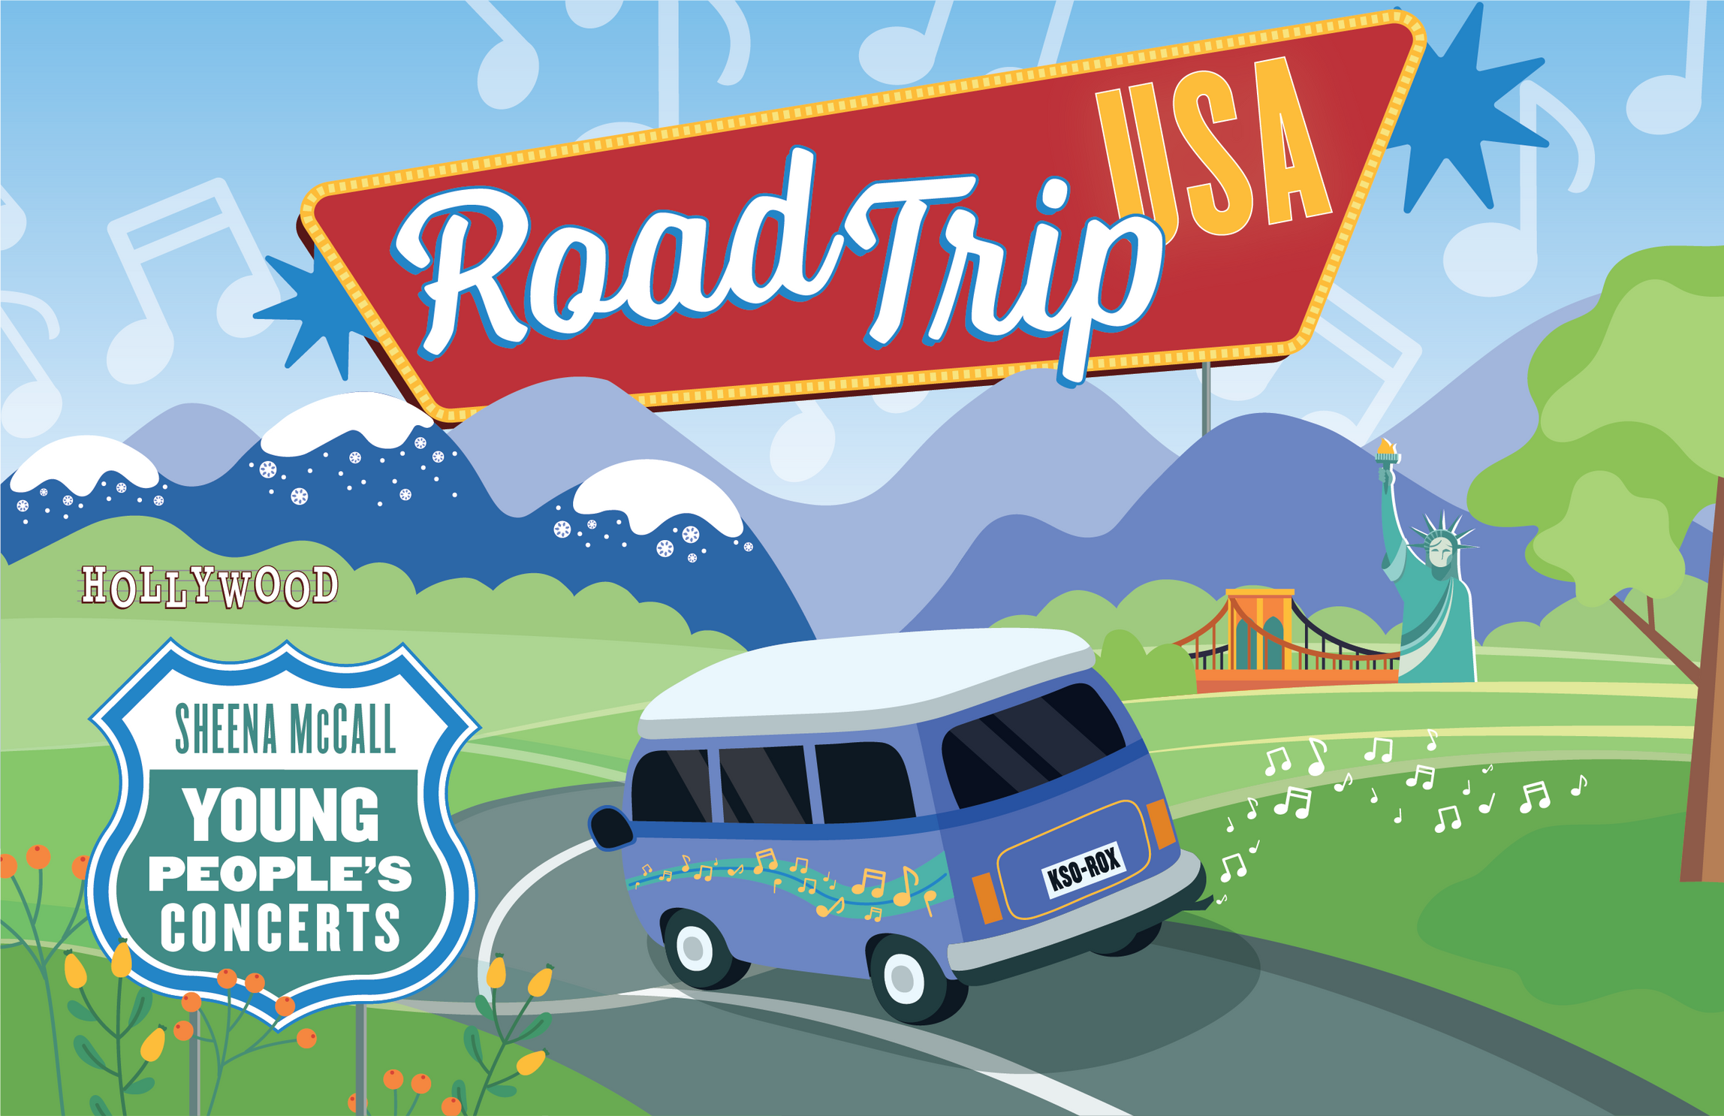


2025 Teacher Guide
Aram Demirjian, Music Director

Slide 2




Table of Contents
Artists
Meet Aram Demirjian
Meet the KSO
Composers
Samuel Ward
John Phillip Sousa
George Gershwin
Michael Gilbertson
Michael Daugherty
Florence Price
Woody Guthrie
Aaron Copland
William Grant Still
Ferde Grofé
John Williams
3
4
5
6
7
8
9
10
11
12
13
14
15
Digital Resources
Lesson 1
Compose a Song
Lesson 2
Road Trip USA Bingo
Lesson 3
Anatomy of the Orchestra
Lesson 4
Road Trip Map
Standards
Sponsors/Acknowledgements
Program
17
18
19
22
33
35
36
37

Slide 3


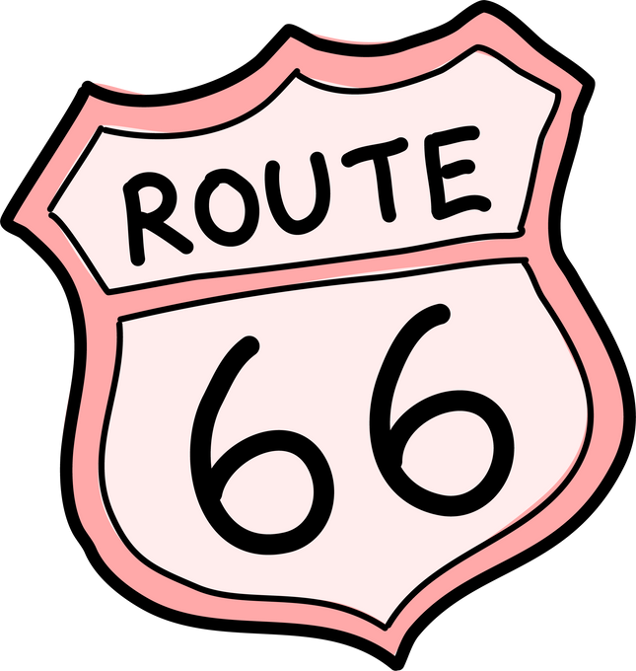

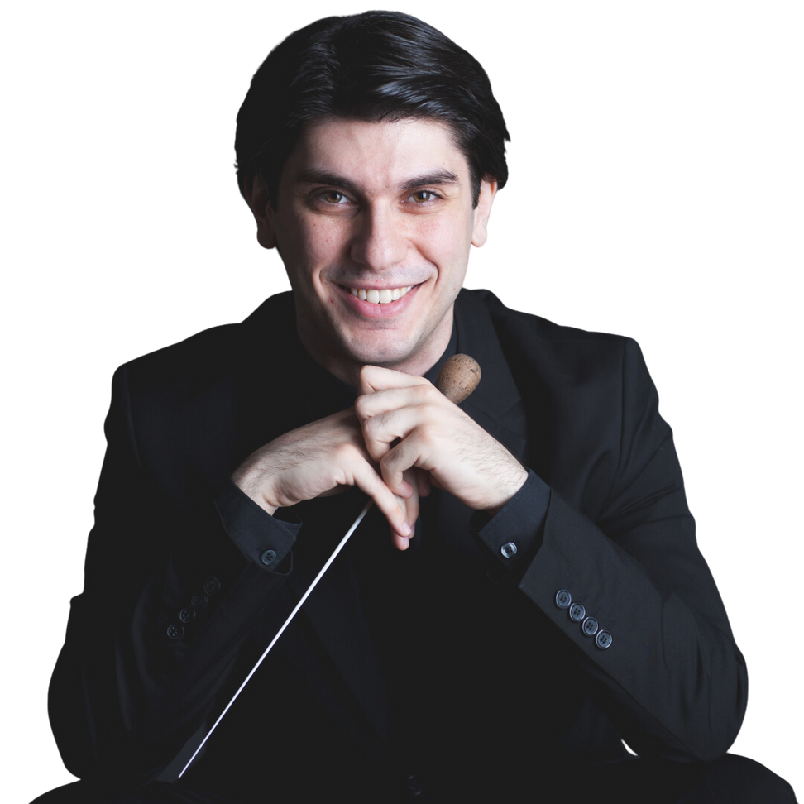

Meet Aram Demirjian
Aram Demirjian is the Music Director of the Knoxville Symphony Orchestra (KSO). He has been conducting the KSO for 10 years! Aram has been praised for his “graceful, energetic direction” (Sarasota Herald Tribune) and dynamic programming for people of all ages.
He is a champion of American music and is passionate about emphasizing music by living composers and artists from underrepresented groups in his programming. In addition to his leadership in Knoxville, Aram is a frequent guest conductor with orchestras across the United States and has also appeared with ensembles internationally!
Aram holds a joint Bachelor of Arts in Music and Government from Harvard University, and a Master of Music in Orchestral Conducting from New England Conservatory. A native of the Boston area, he currently resides in Knoxville with his wife, daughter, and their goldendoodle, Kermit.
3

Slide 4
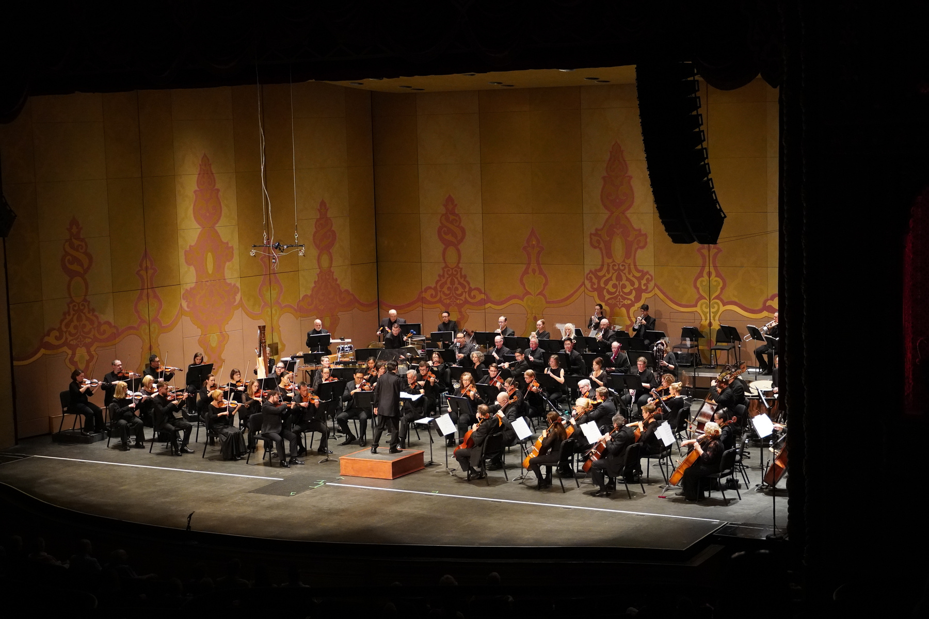
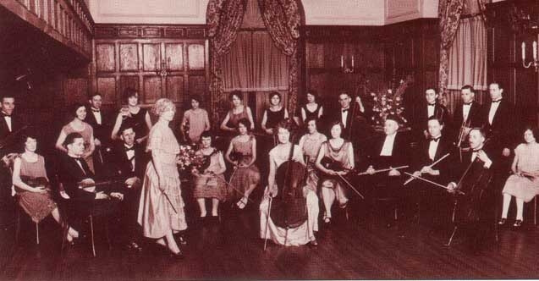
Meet The KSO
The Knoxville Symphony Orchestra (KSO) was founded in 1935.
This season marks the KSO’s 90th anniversary!
The orchestra began with conductor Bertha Walburn Clark, who helped bring professional orchestral music to Knoxville.
Over the years, many talented conductors and musicians have led the KSO to grow and become one of the finest regional orchestras in the United States.
Today, the KSO continues to perform a wide variety of music and share it with audiences throughout the community.
4

Slide 5

What is a
composer?
Can you think of an
example of a song about
a place?
A composer is an individual who writes music. This person can write music for groups as large as a symphony or for a single instrument. Often times in orchestral works, composers use music to tell a story. Composers can write pieces of music based on many different things, such as dreams, places, people, events, or poems.
5

Slide 6


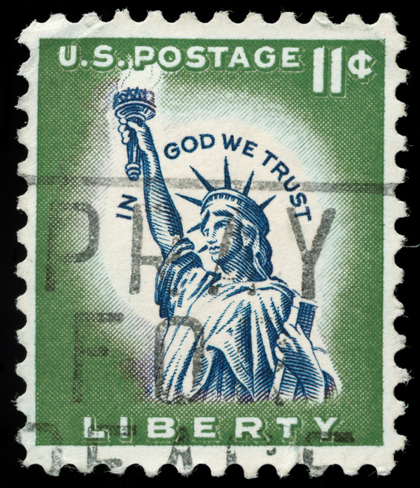

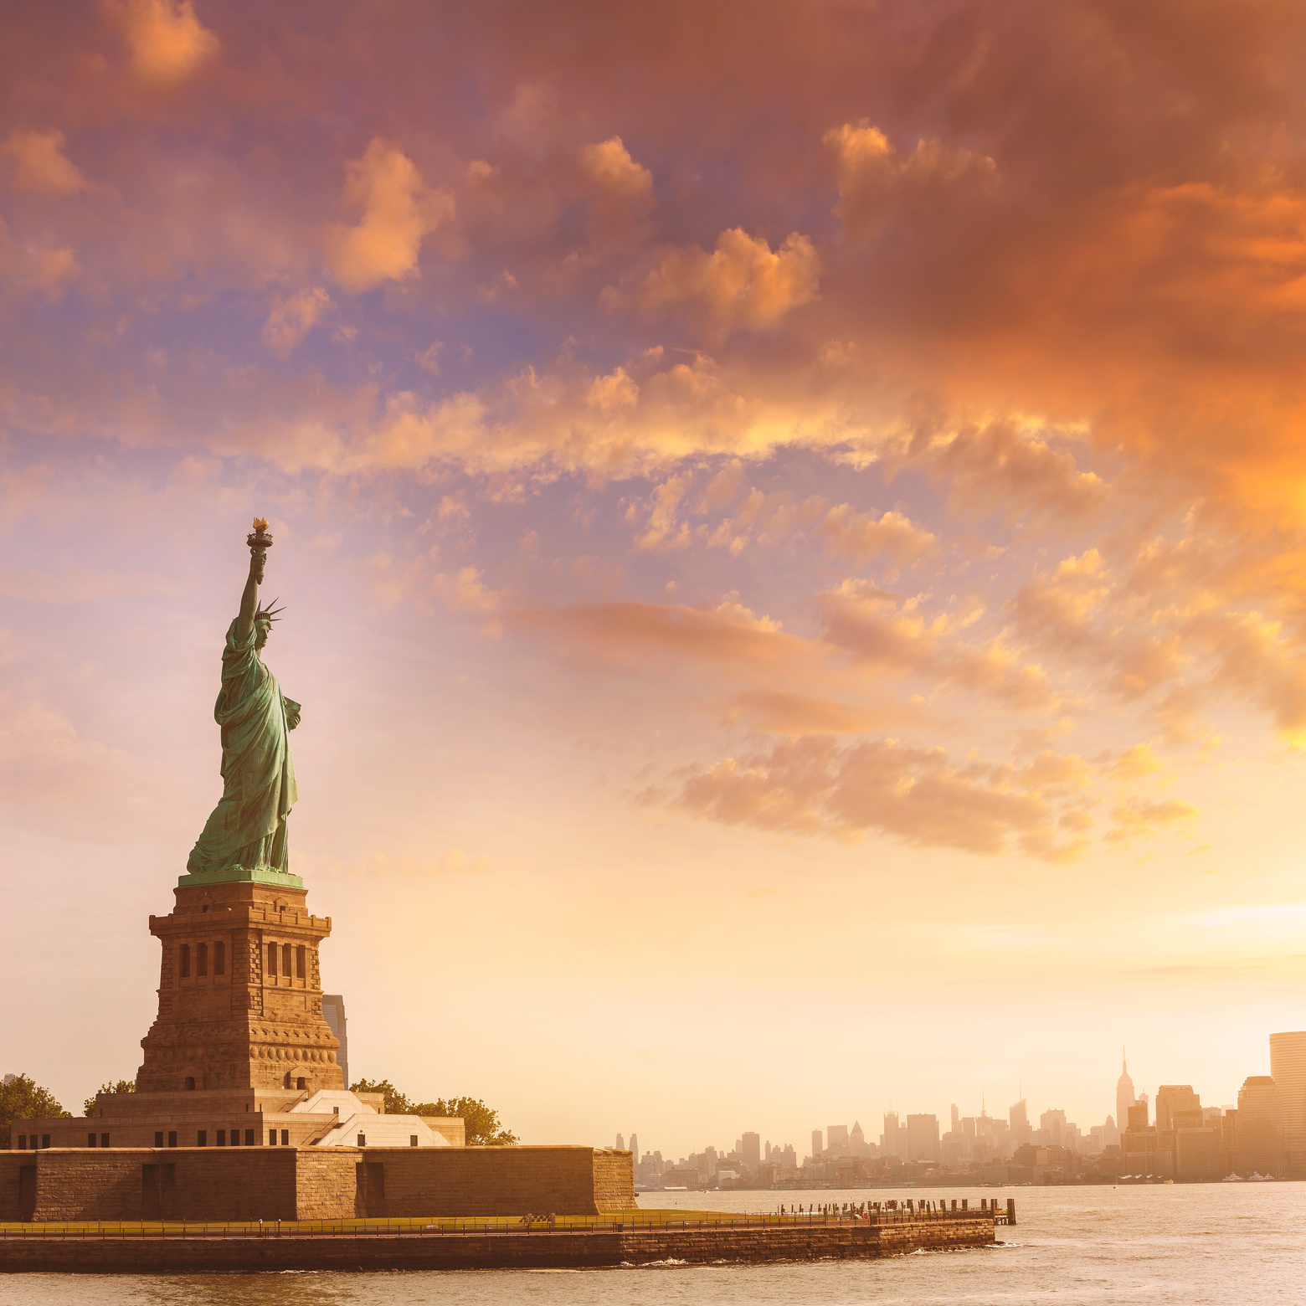
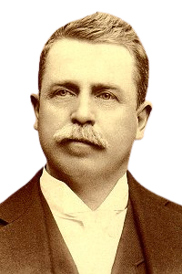
SAMUEL WARD
STATUE OF LIBERTY
Lived:
December 28, 1848 - September 28, 1903
From:
Newark, New Jersey
Samuel A. Ward was an American organist and composer. As a child, he played accordion and taught piano lessons to help support his family. When he was 16, he began performing as a church organist in New York City .
In 1890, Ward founded and directed a male singing group in New York called The Orpheus Society. This group mainly performed Ward’s arrangements. Later in his life, he returned to his hometown of Newark where he opened a music store.
He is most remembered for composing his piece “Materna,” which was later combined with Katharine Lee Bates’s poem “America” to create the song “America The Beautiful” in 1888.
In 1970, Ward was inducted into the Songwriters Hall of Fame.
6

Slide 7
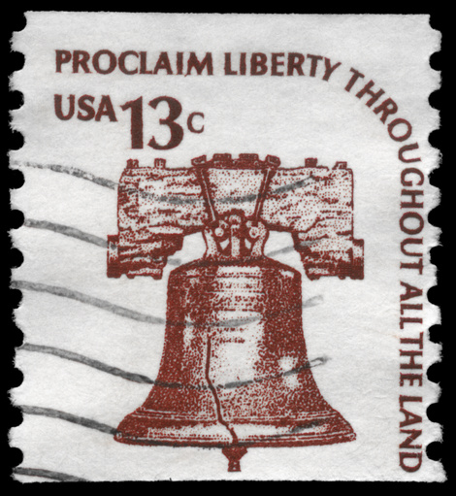

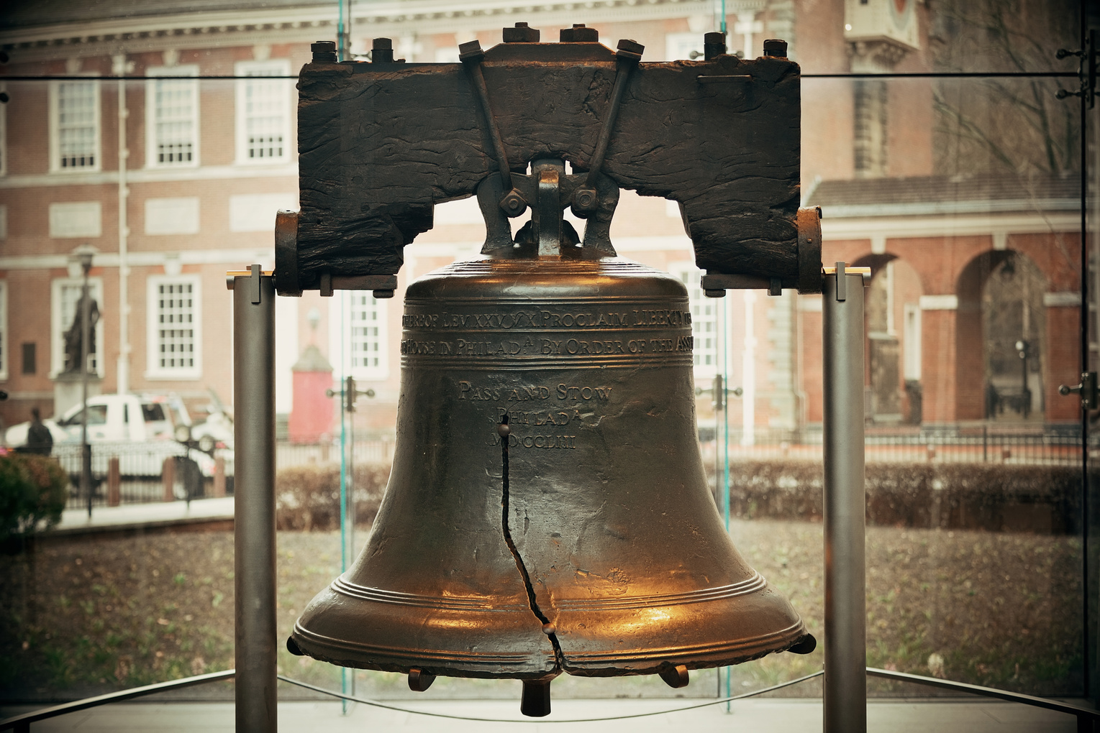
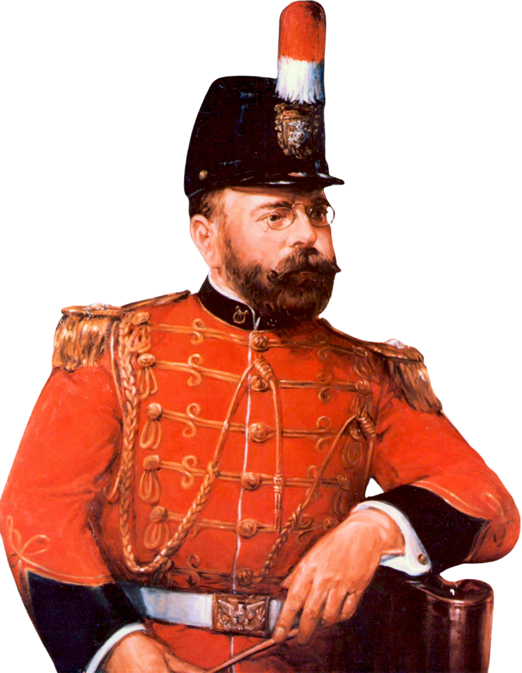
JOHN PHILLIP SOUSA
LIBERTY BELL
Lived:
November 6, 1854 - March 6, 1932
From:
Washington D.C
Sousa was an American composer and conductor, known for his military marches. He began studying music at age 6, learning to play the violin and many other instruments. At age 13, his father enlisted him in the U.S. Marine Band where he served as an “apprentice” musician while continuing to study music theory and composition.
In 1880, Sousa was appointed the Director of the Marine Band and spent the next 12 years developing the band into one of the best in the world. After retiring from the Marine Band, Sousa focused on writing music. He also created his own band, The Famous Sousa Band, that toured all over the world, and helped create a new instrument similar to the tuba: the Sousaphone!
During World War I, Sousa led the Naval Reserve Band in Illinois and continued to conduct the Sousa Band until his death in Reading, Pennsylvania.
Sousa is known as “The March King.” He composed 136 marches, including “The Stars and Stripes Forever,” which is the official march of the United States.
7

Slide 8
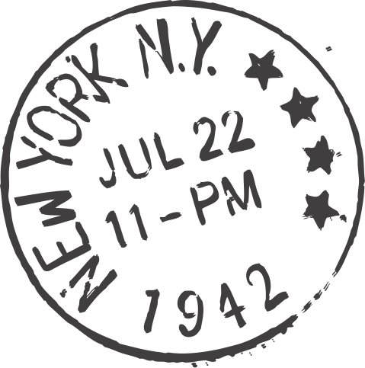
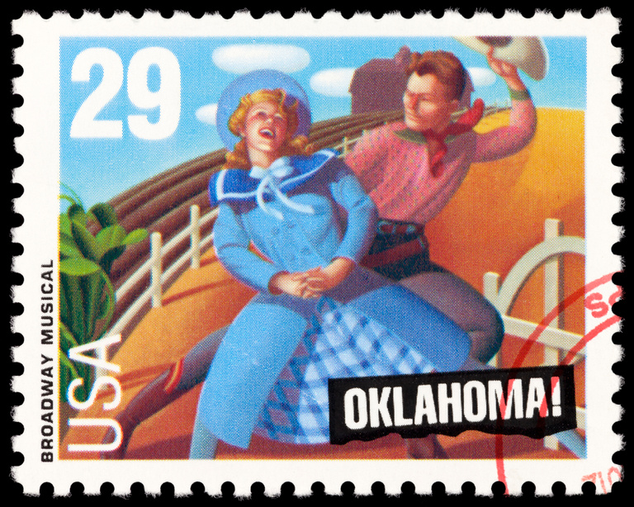
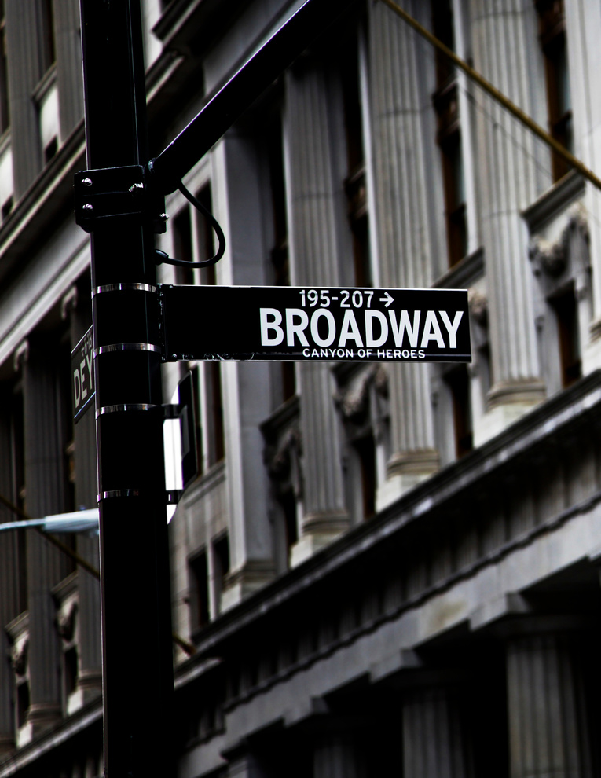
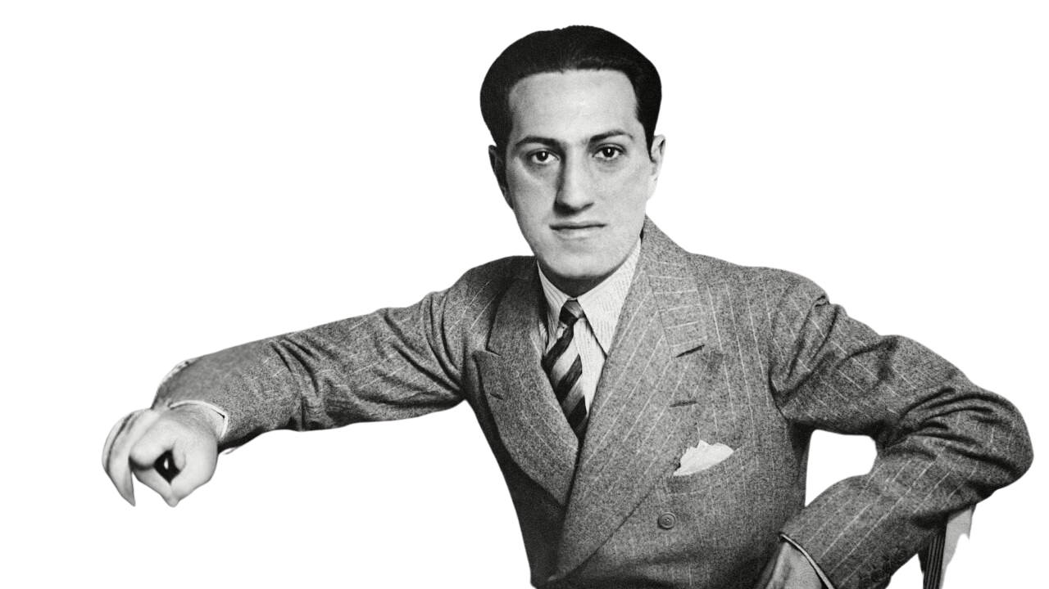
GEORGE GERSHWIN
BROADWAY
Lived:
September 26, 1898 - July 11, 1937
From:
Brooklyn, Yew York
George Gershwin was an American composer and pianist who composed jazz, popular, and classical music. He loved music so much that he taught himself to play piano as a kid.
When he grew up, George and his bother, Ira, wrote songs and musicals that became big hits on Broadway, such as “Porgy and Bess” (1935). After working on Broadway, Gershwin moved to Hollywood where he wrote music for television, movies, and opera.
Gershwin was known for composing unique music that mixed jazz and classical styles, like his famous “Rhapsody in Blue” and “An American in Paris.”
8

Slide 9
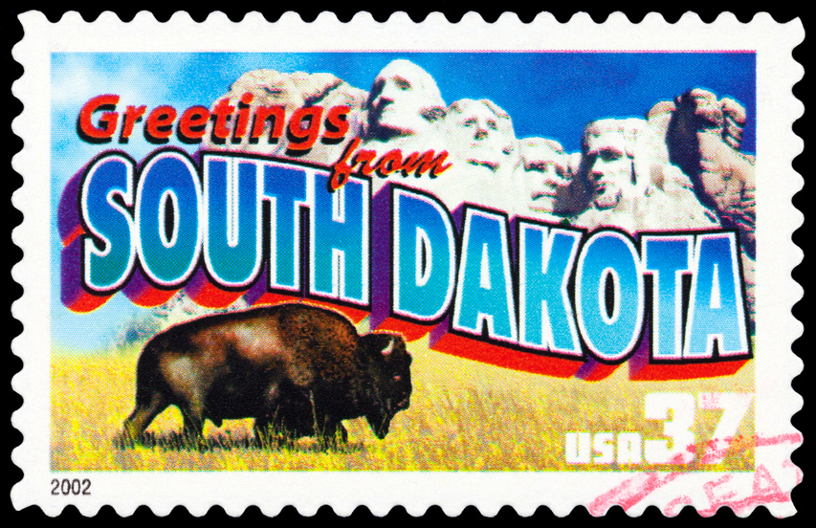

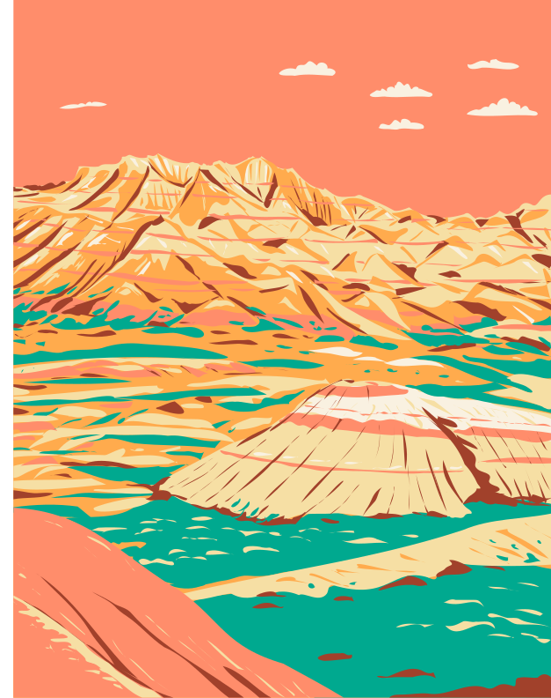

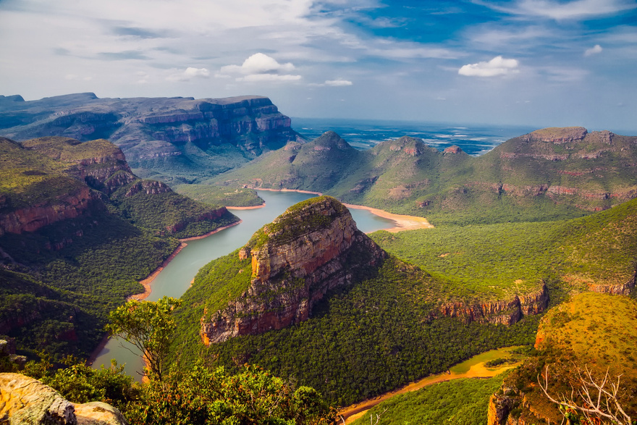
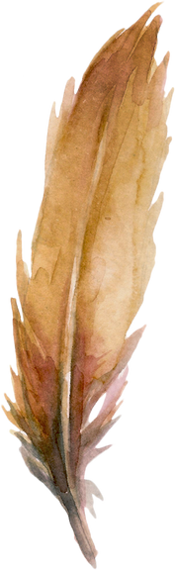

MICHAEL GILBERTSON
BADLANDS NATIONAL PARK
Lived:
1987-
From:
Dubuque, Iowa
Michael Gilbertson is a living composer whose music has been played by orchestras, bands, and choirs all over the world. He was a finalist for the Pulitzer Prize in Music, one of the highest honors a composer can receive.
Michael studied music at The Juilliard School in New York City and at Yale University. He also started a festival in his hometown called “ChamberFest Dubuque,” which brings young musicians to perform and teach students.
9

Slide 10

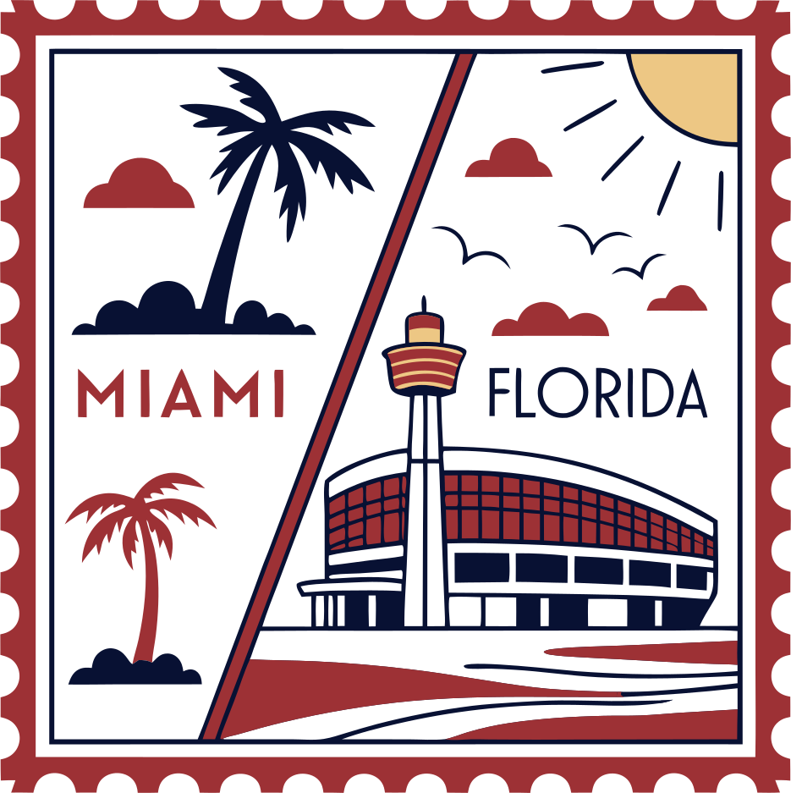


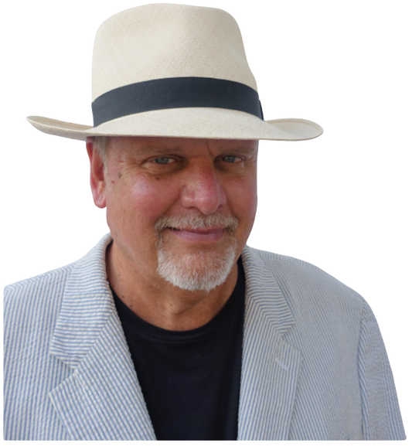
MICHAEL DAUGHERTY
ALLIGATOR ALLEY
Lived:
April 28,1954 -
From:
Cedar Rapids, Iowa
Michael Daugherty is an American composer, pianist, and teacher. He was born into a musical family and learned how to play piano when he was 8 years old. Michael studied music all over the world, including in Paris, Germany, and New York. He earned a PhD in composition at the Yale School of Music.
Daugherty is famous for writing music inspired by his travels, American stories, history, and pop culture His music has been performed all over the world and has won SIX Grammy Awards.
Today, in addition to writing music, Daugherty is a Professor of Composition at the University of Michigan.
10

Slide 11
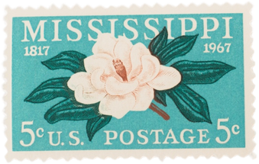
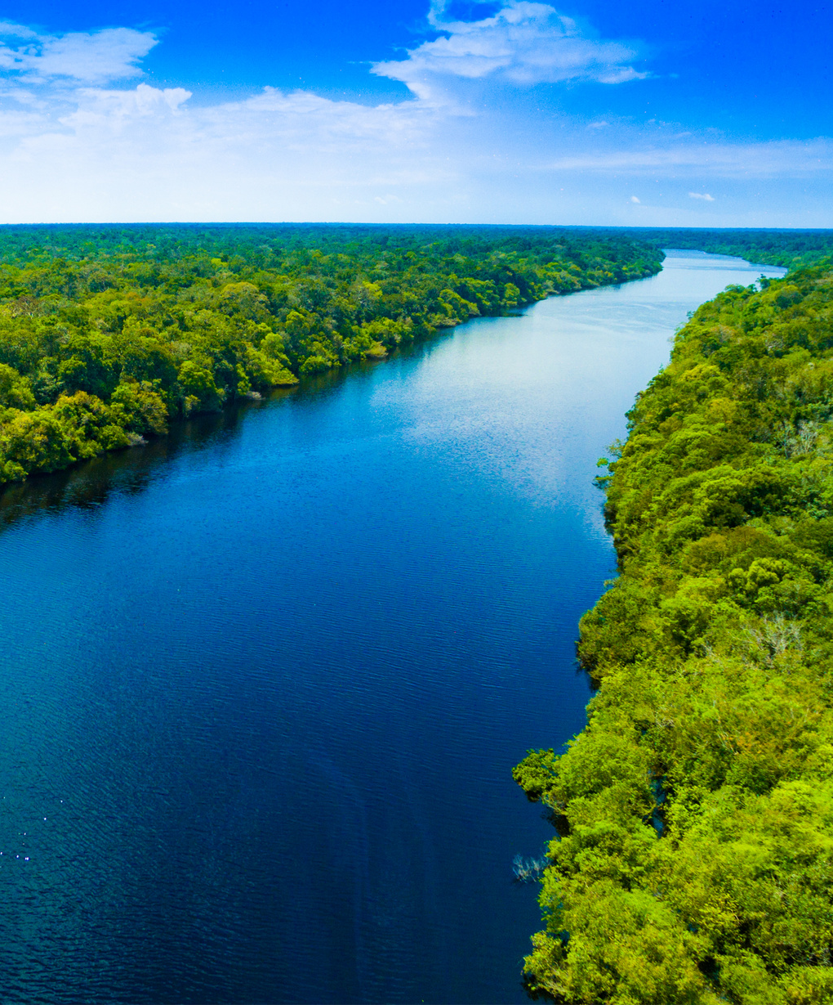
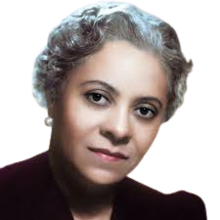
FLORENCE PRICE
MISSISSIPPI RIVER
Lived:
April 9,1887 - June 3, 1953
From:
Little Rock, Arkansas
Florence Beatrice Price was an American composer, pianist, organist, and music teacher. She was a talented child prodigy and went on to study at the New England Conservatory of Music.
Price wrote symphonies, piano music, spiritual arrangements, and more, blending classical traditions with the rhythms and melodies of African American music. She is known as the first African American women to have her music performed by a major orchestra.
Price wrote over 300 musical compositions! Much of her work was lost after she died and was not discovered until over 55 years later in her childhood home.
11

Slide 12
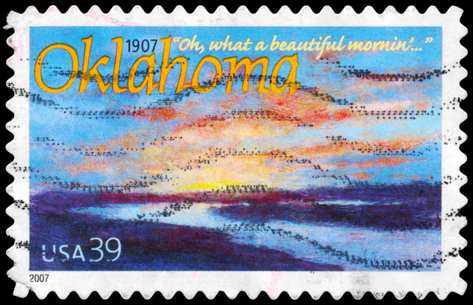


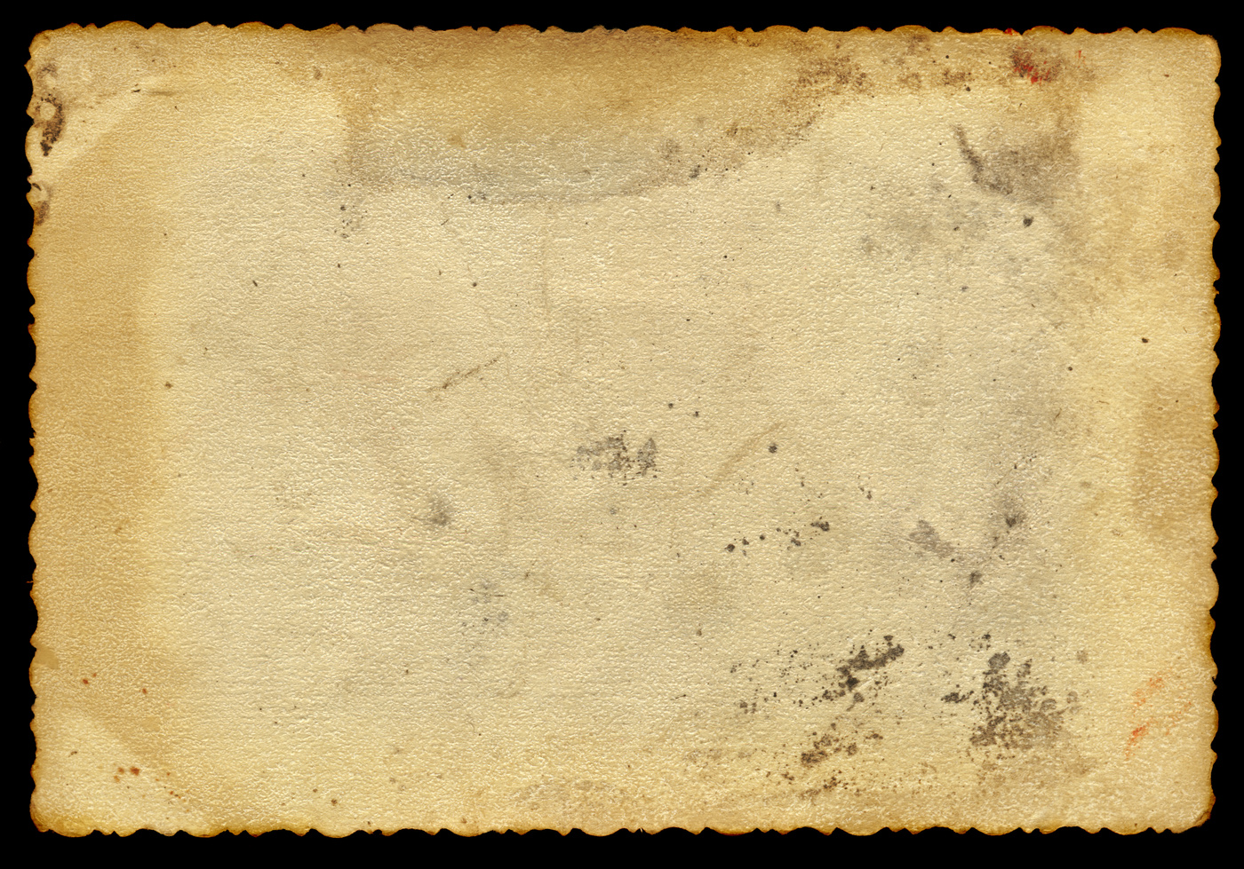
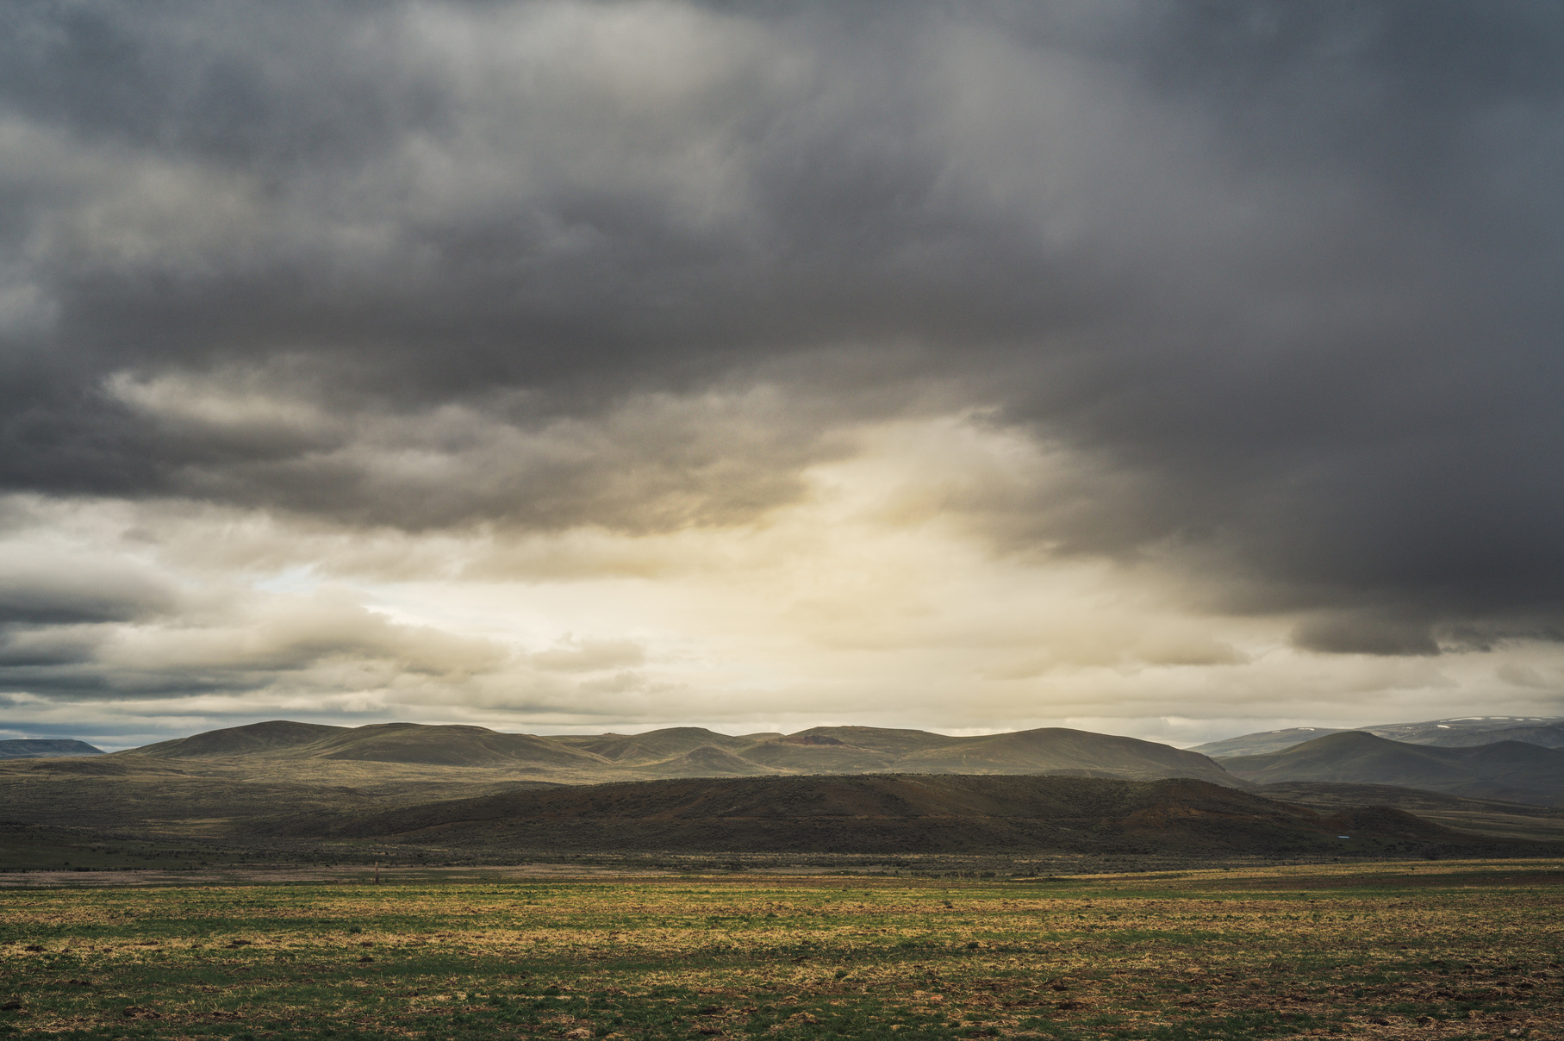
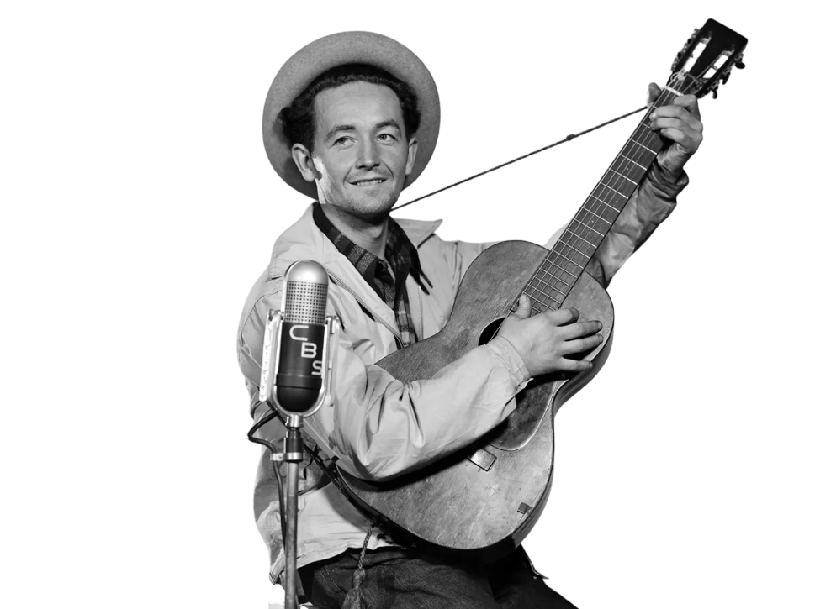
WOODY GUTHRIE
THE GREAT PLAINS
Lived:
July 14, 1912 - October 3, 1967
From:
Okemah, Oklahoma
Woodrow Wilson Guthrie, “Woody,” was an American folk singer and songwriter who told stories about everyday people through his music. He grew up in Oklahoma and traveled across the country during the Great Depression, singing about workers, farmers, and families trying to make a better life.
His most famous song is “This Land Is Your Land,” which has become one of America’s most beloved folk songs. Woody believed music could bring people together and inspire change, and his songs are still sung by people all over the world today.
12

Slide 13
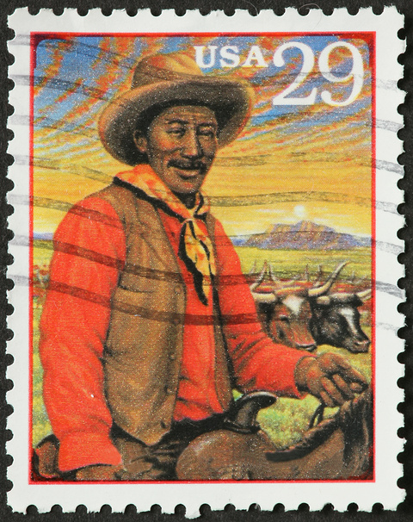
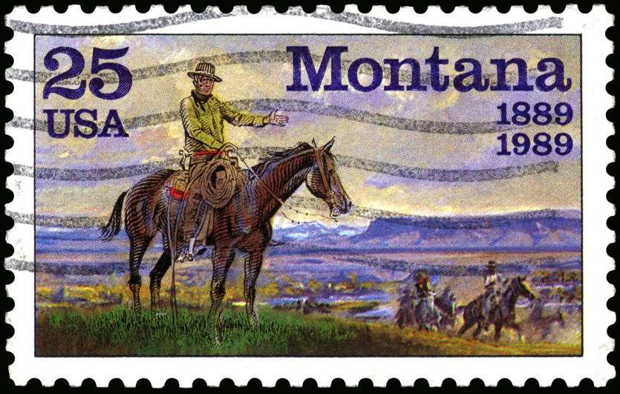


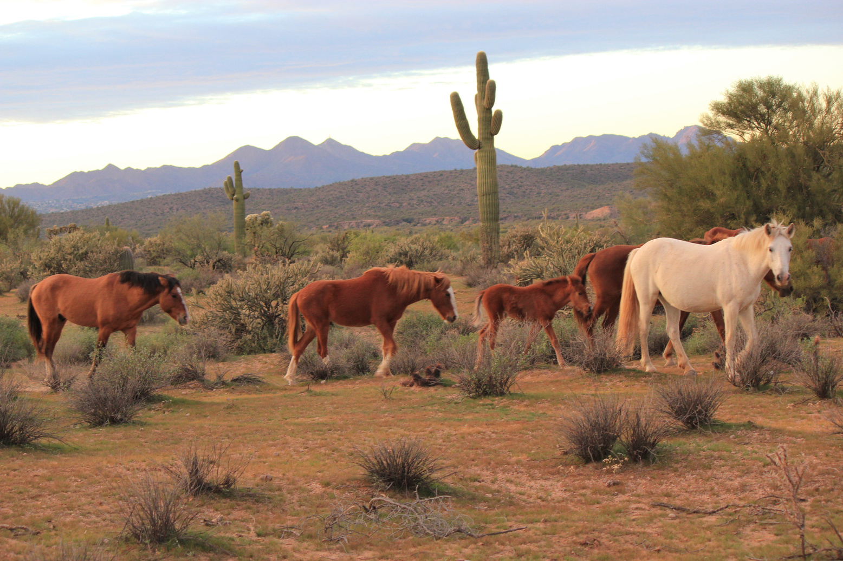
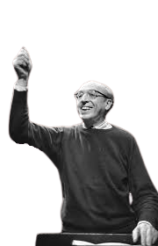
AARON COPLAND
THE WEST
Lived:
November 14,1900 - December 2, 1990
From:
Brooklyn, New York
Aaron Copland was a 20th century American composer, often referred to as the “Dean of American Music.” At age 20, he studied music in Paris and then moved back to the U.S., where he worked as a composer. Copland’s music was often inspired by landscapes and the American spirit.
Copland is best known for the music he wrote in the 1930s and 1940s. These pieces were written in an “everyday” style, meaning they were designed to be accessible for everyone to enjoy.
In addition to composing, Copland was a teacher, conductor, writer, and critic.
13

Slide 14
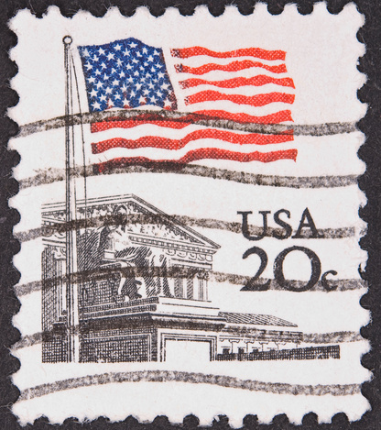
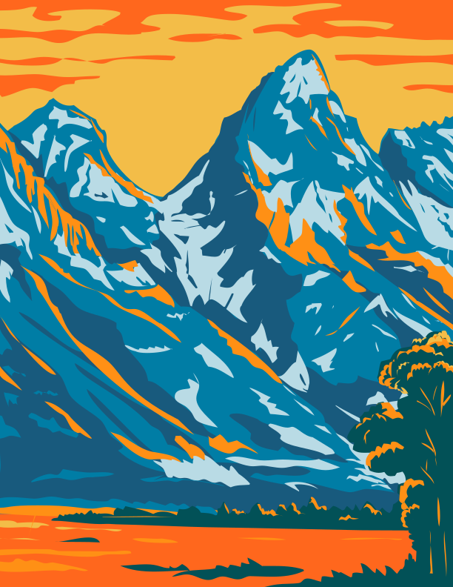
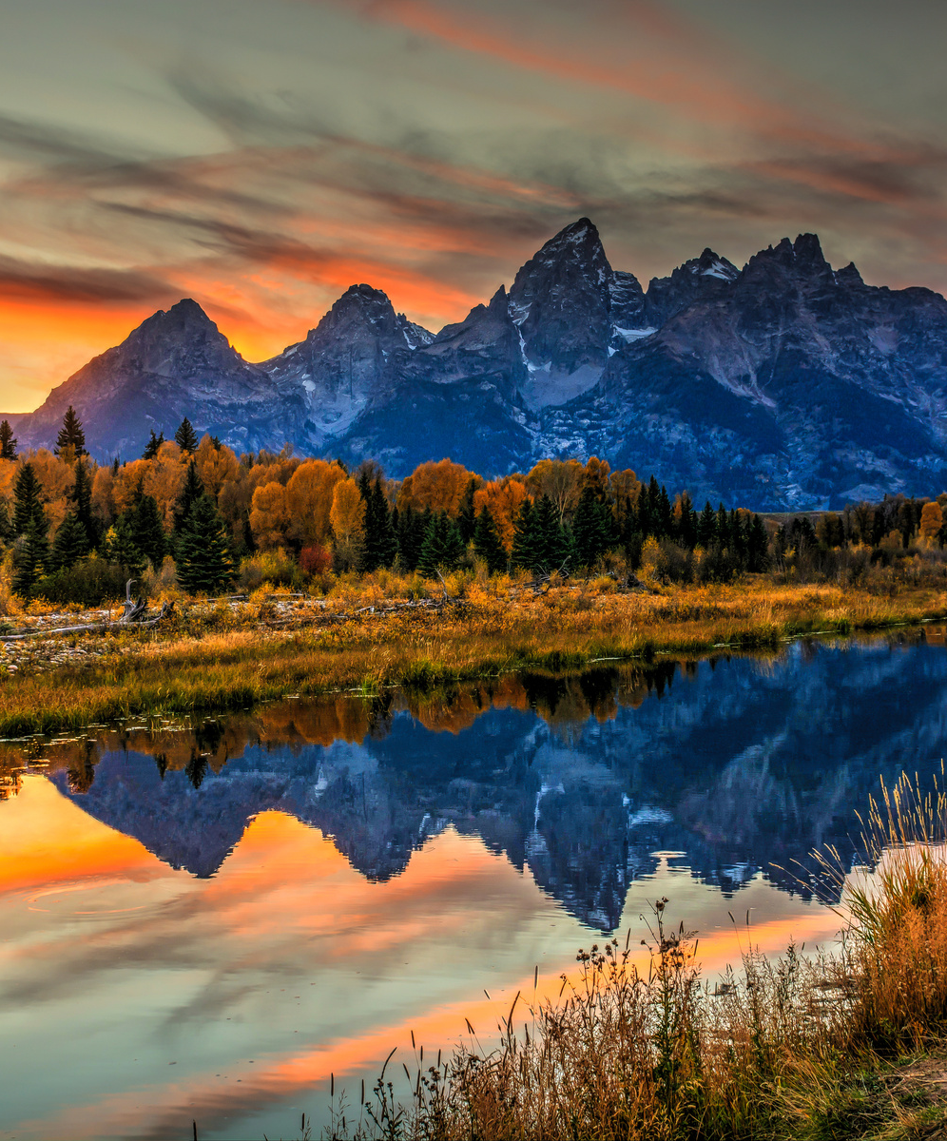
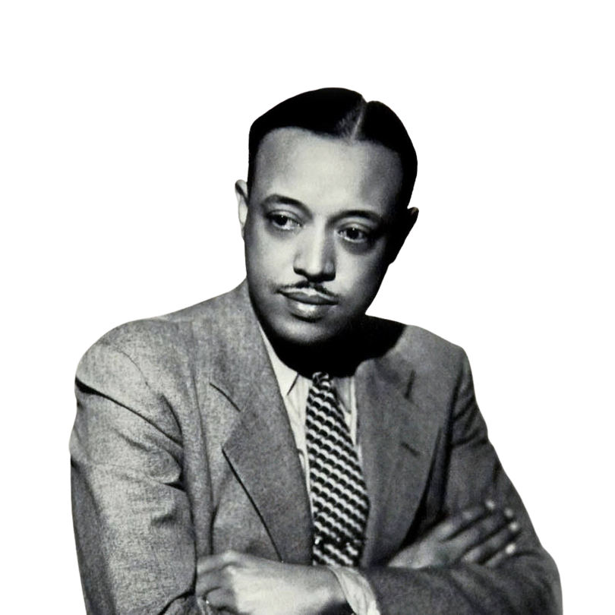
WILLIAM GRANT STILL
GRAND TETON
Lived:
May 11,1895 - December 3, 1978
From:
Woodville, Mississippi
William Grant Still studied composition at Oberlin Conservatory of Music in Ohio. Before studying music, he studied medicine at Wilberforce University. His work is characterized by its blending of classical techniques with jazz, blues, and spirituals, creating a unique American sound.
William Grant Still’s “Afro-American Symphony” was the first symphony by a black composer to be performed by a major orchestra. Still was also the first African American to conduct a major American symphony orchestra.
14

Slide 15
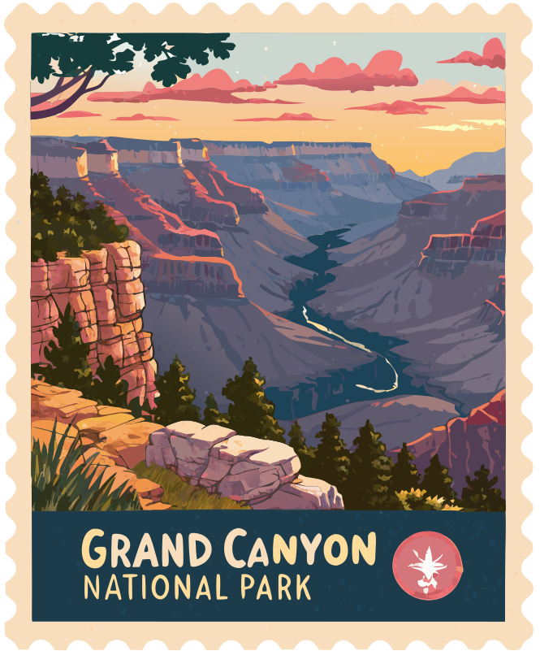
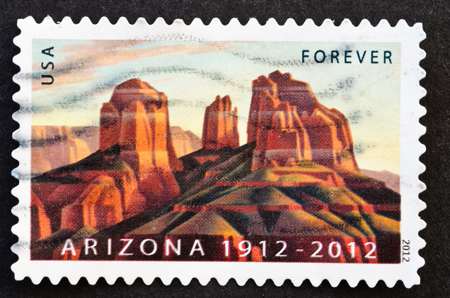
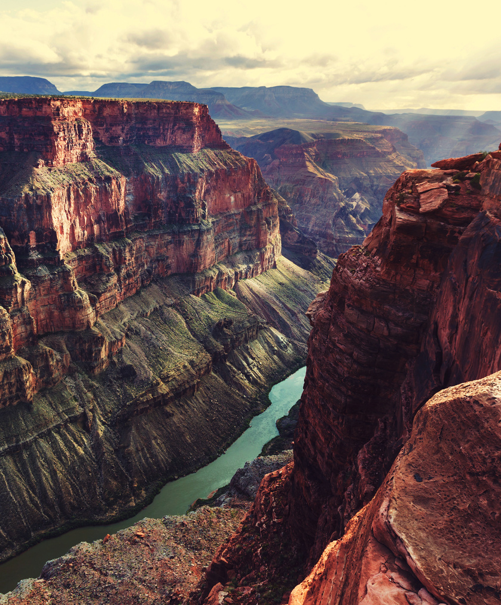
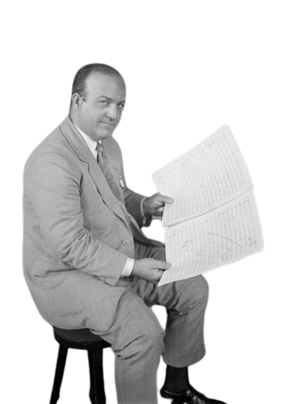
FERDE GROFÉ
GRAND CANYON
Lived:
March 27,1892- April 3,1972
From:
New York City, New York
’
’
Ferdinand Rudolph von Grofé, known as Ferde Grofé, was an American composer, arranger, pianist, and instrumentalist. While Grofe could play many instruments, his favorite was the piano.
Grofé was good friends with George Gershwin. His arrangement of Gershwin’s “Rhapsody in Blue” is what helped bring the piece to fame.
His most famous composition is the “Grand Canyon Suite” (1931).
’
’
15

Slide 16
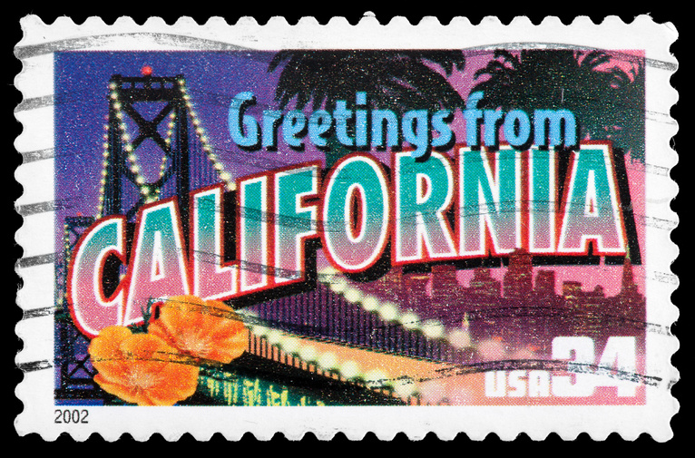


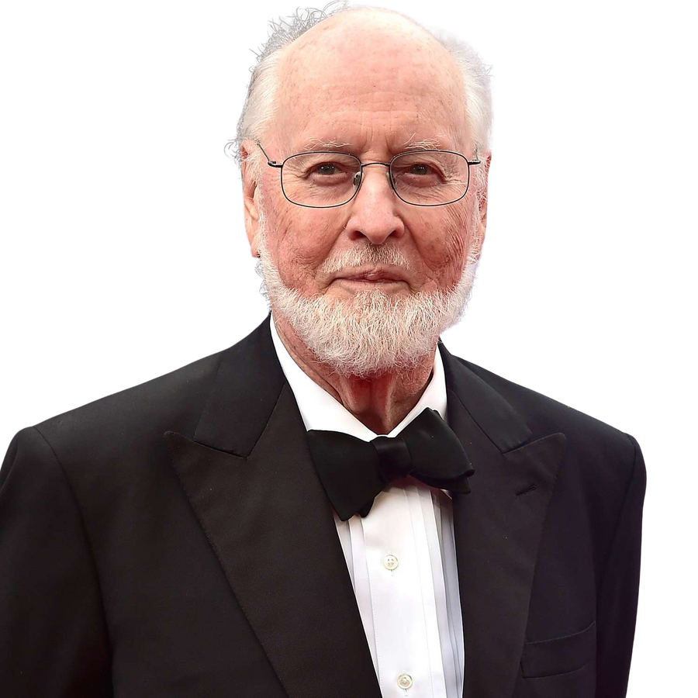
JOHN WILLIAMS
HOLLYWOOD
Lived:
February 8, 1932 -
From:
Long Island, New York
John Williams is an American composer and conductor best known for his film scores. His music can be heard in movies such as Star Wars, Harry Potter, and E.T. the Extra-Terrestrial. He has also written many pieces for orchestras, other ensembles, and solo instruments.
Williams has won 26 Grammy Awards, 5 Academy Awards, and has the second most Academy Award nominations (54 total!). He was inducted into the Songwriters Hall of Fame in 1998.
Williams is 93 years old today and still continues to write music for movies!
16

Slide 17






Digital Resources
Scan the QR codes or click below to access additional materials to help prepare students for their trip with the Knoxville Symphony Orchestra!
KSO Home Page
Audio File Playlist
Roadtrip Map
Click Here
Click Here
Click Here
17

Slide 18





Lesson One: Compose a Song
Choose a familiar song and rewrite the lyrics to be about a place of your choosing!
Have students rewrite their song about Tennessee or let each student choose their own location for a variety of stops on your own classroom road trip!
18

Slide 19




This Land Is Your Land is a song written about the beautiful United States.
Rewrite the lyrics to describe a specific location!
Perform your new song for your class!
This Land Is Your Land
Words and Music by Woody Guthrie
This land is your land, this land is my land
From California to the New York island,
From the redwood forest to the Gulf Stream waters;
This land was made for you and me.
As I was walking that ribbon of highway
I saw above me that endless skyway;
I saw below me that golden valley;
This land was made for you and me.
Check Out Our Lyrics!
Knoxville is your town, Knoxville is my town,
From KSO concerts to the UT Vols game,
From the Tennessee Theatre to the World’s Fair Park Sunsphere,
Knoxville was made for you and me!
Click for full lyrics!

Slide 20


Lesson Two
Roadtrip
Use the terms provided to create your own Bingo Card.
Bring it with you to the concert or listen in the classroom!
USA
Bingo
20

Slide 21
Use these terms to fill out your bingo card!
If there are music terms you know that you don’t see here, you can use those too!
Instruments You
Might See/Hear:
Music
Terms:
Music You Might Hear:
Music from a Movie
Music you have heard before
A song you can sing
A Patriotic Tune
Music you can dance to
A March
Violin/Viola
Cello/Bass
Flute
Clarinet
Oboe
Trumpet
French Horn
Tuba
Snare Drum
Bass Drum
Woodblock
Cymbals
Timpani
Forte (loud music)
Piano (Soft music)
Allegro (fast music)
Adagio (slow music)
Crescendo (music getting louder)
Decrescendo (music getting softer)
Staccato (short, bouncy notes)
Legato (smooth, connected notes)
Tutti (the whole orchestra)
Solo (one instrument featured alone)
Things you might see
during the concert:
“A” Tuning note
The Concertmaster
The Maestro taking a bow
The whole orchestra standing
Woodwind player swabbing their instrument
Brass player emptying their spit valve

Slide 22


Use the provided Bingo Card with the Audio Links provided on page 17.

Slide 23
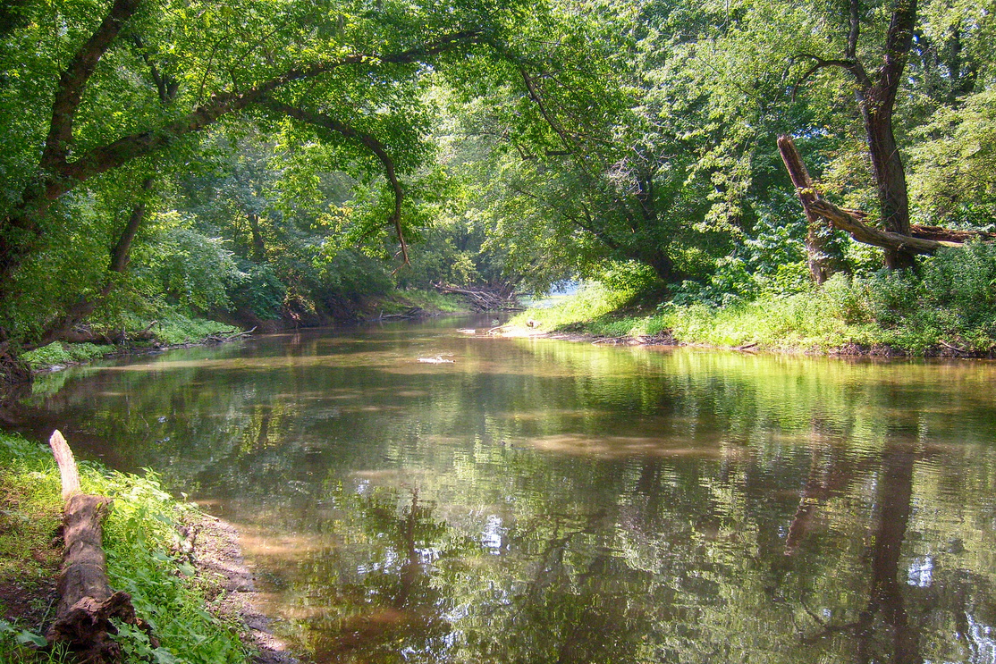


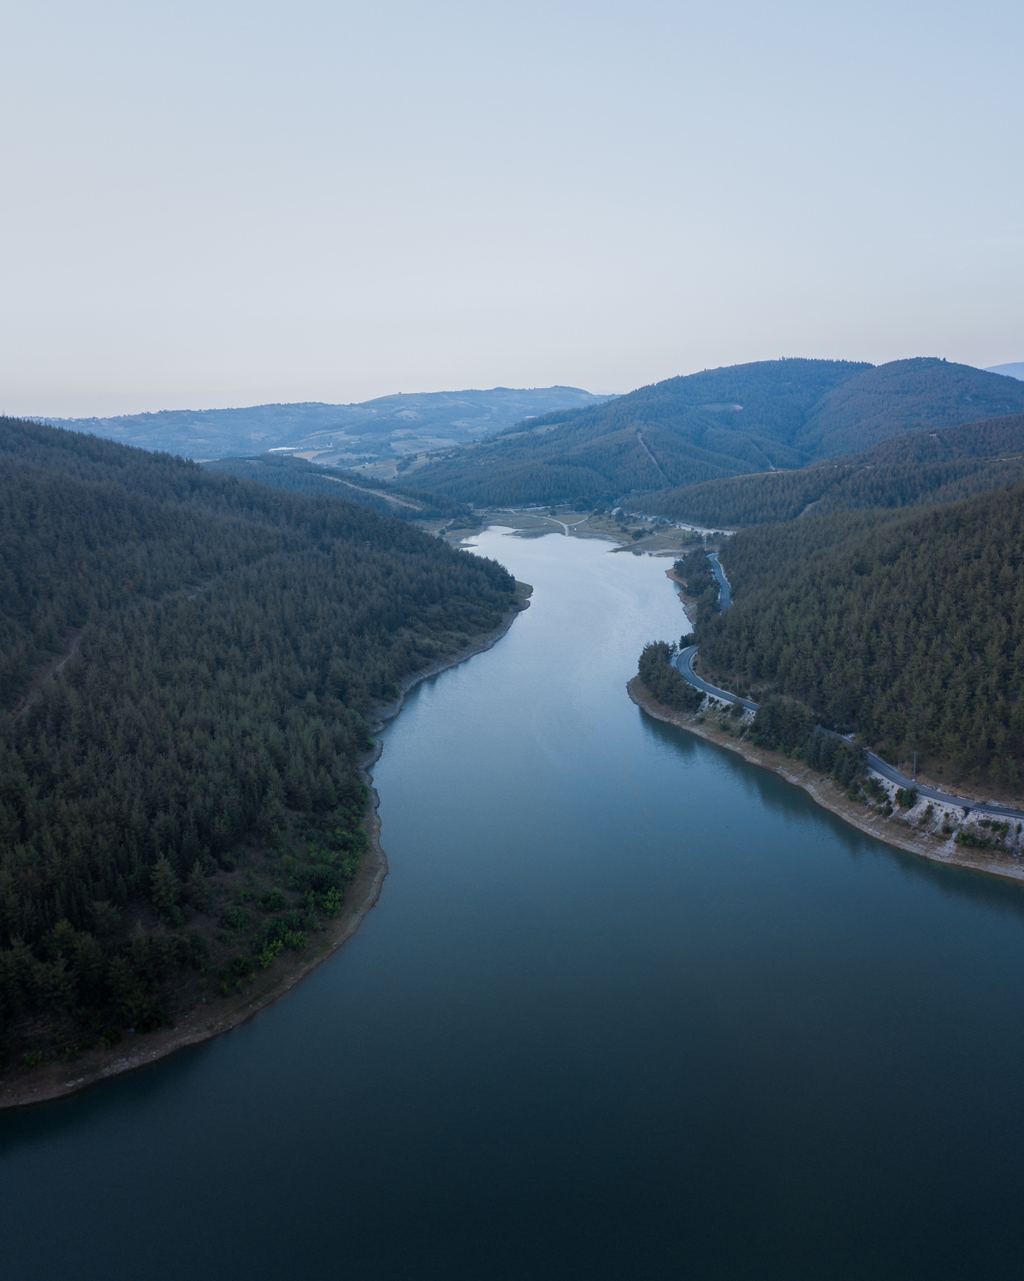
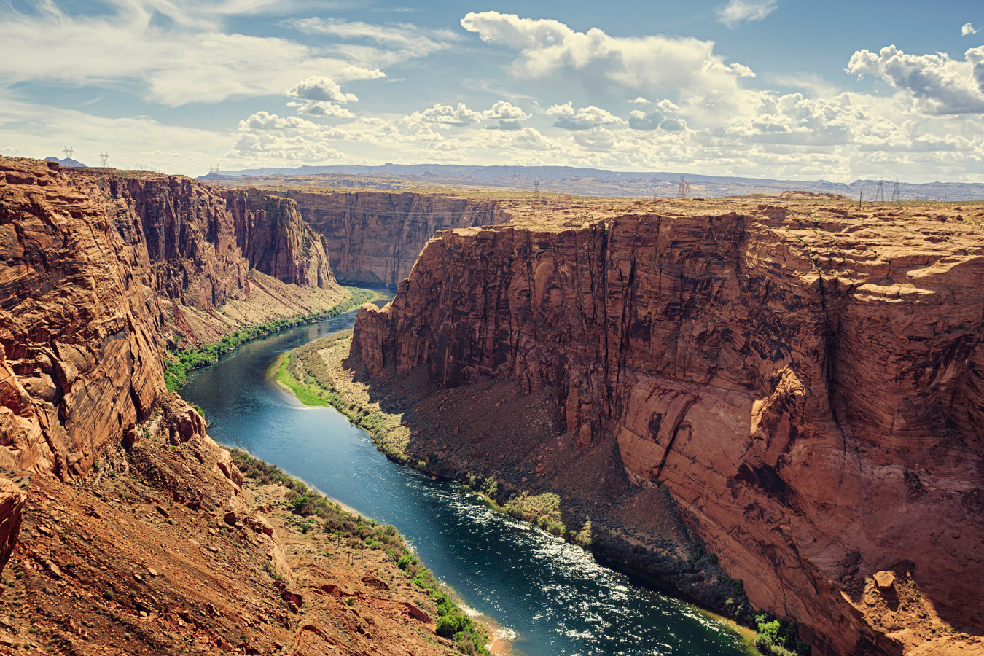
Lesson Three
Cut and paste the instruments of the orchestra and place them on the map.
23

Slide 24
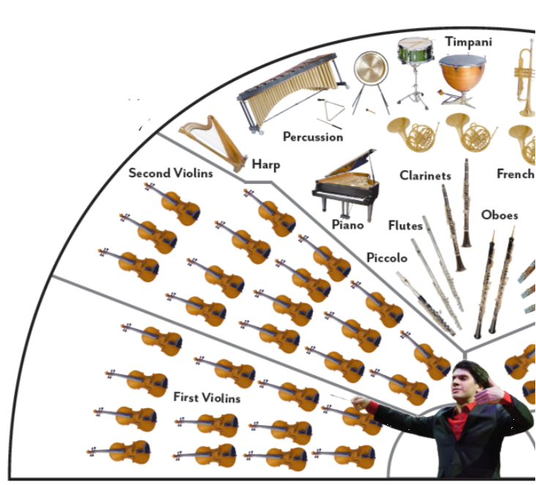
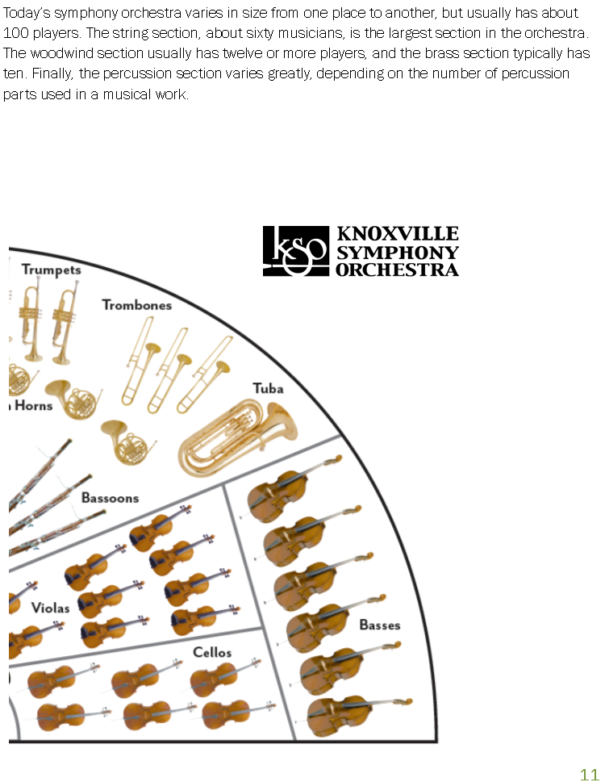
The Knoxville Symphony Orchestra
This seating chart shows how you might see the Knoxville Symphony Orchestra arranged when you come to the Young People’s Concert.
The players are seated in a semicircle facing the conductor.
Today’s symphony orchestra varies in size from one place to another but usually has about 100 players. The string section, about 60 musicians, is the largest section in the orchestra. The woodwind section usually has 12 or more players, and the brass section typically has 10. Finally, the percussion section varies greatly, depending on the number of percussion parts used in a musical work.

Slide 25
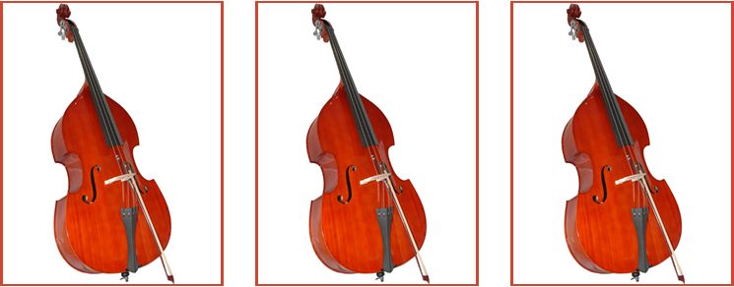
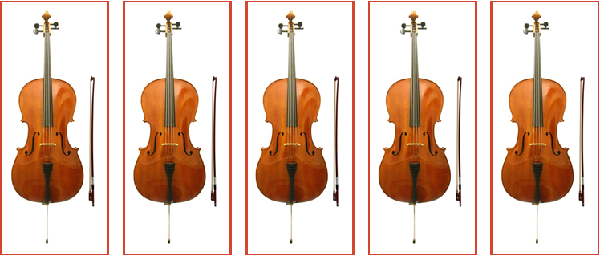
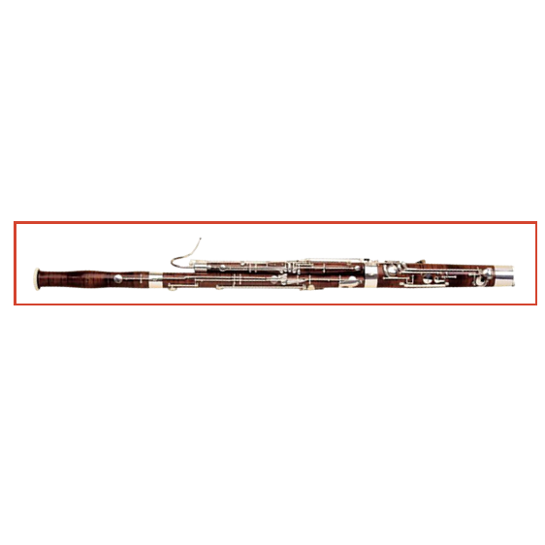




Slide 26
Leave blank for cut outs

Slide 27



Slide 28
Leave blank for cut outs

Slide 29






Slide 30
Leave blank for cut outs

Slide 31











Slide 32
Leave blank for cut outs

Slide 33



Woodwinds
Percussion
Brass
Strings
Strings
Strings

Slide 34



Lesson 4
CREATE YOUR OWN ROAD MAP
How many Road Trip USA landmarks can you place on a map?
Mark our Road Trip Destinations on the next page. Connect the destinations to create your own road trip route!
Print a map for each student or do it as a class.
Landmarks are paired with composers pages 6-16.
34

Slide 35
Road Trip USA!!!
Plan your trip! Mark our road trip destinations on the map!

Slide 36


Standards
The Sheena McCall Young People’s Concert aligns with the National Standards for General Music and Geography.
Click the link or scan the QR Code to access a full list of National Standards covered in this Teacher Guide and Concert.
CLICK HERE
36

Slide 37






Sponsors and Acknowledgements
Randy and Jenny Boyd
37

Slide 38



Sponsored by
Randy and Jenny Boyd
Aram Demirjian, Music Director
Presents
Sheena McCall Young People's Concert
Knoxville Fall 2025
knoxvillesymphony.com

Slide 39
Road Trip USA
Aram Demirjian, Conductor
America the Beautiful
Samuel Ward
The Liberty Bell
John Phillip Sousa
Gershwin in Concert
George Gershwin
Reflections on Rushmore
Michael Gilbertson
Shenandoah
Traditional, arr. Bullock
Buckle up for an unforgettable adventure with the Knoxville Symphony Orchestra! With Maestro Aram Demirjian at the wheel, students will embark on a musical journey across the country visiting some of America’s most iconic sights and scenes. From the Liberty Bell to National Parks to the Hollywood sign, this performance brings the spirit of the USA to life as students discover dynamic connections between music, landscapes, and landmarks. Grab your maps and pack your imagination – this is one road trip you won’t want to miss!
Alligator Alley
Michael Daugherty
When the Saints Go Marching In
Traditional, arr. Holcombe
Mississippi River Suite
Florence Price
On the Trail from Grand Canyon Suite
Ferde Grofé
Hoe-Down from Rodeo
Aaron Copland
This Land is Your Land
Woody Guthrie
Flying Music from E.T
John Williams

